Slide 1
Bar Graph of Displacement from Original Position

Slide 4
Bar Graph of Displacement from Original Position

Slide 5
Wave Function
Propagating rarefaction
Fluid displaced to fill void
s
s_{max}
x

Slide 6
Pressure change is large here
Pressure change is almost zero here

Slide 7
Pressure is higher than normal here
Pressure is lower than normal here
Pressure change is almost zero here

Slide 8
Displacement
x
Change in Pressure
x

Slide 9
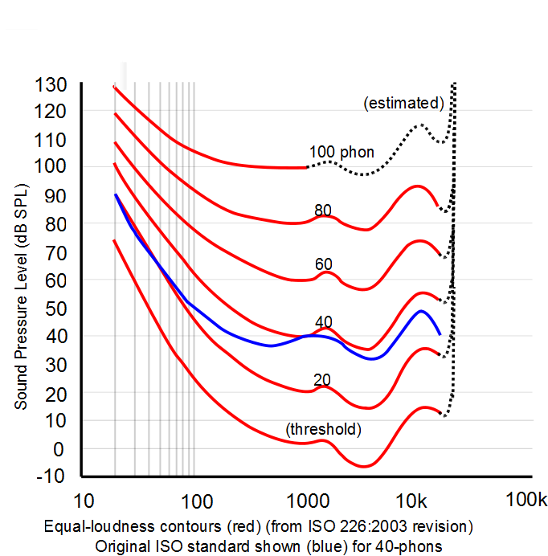
Frequency Response

Slide 10
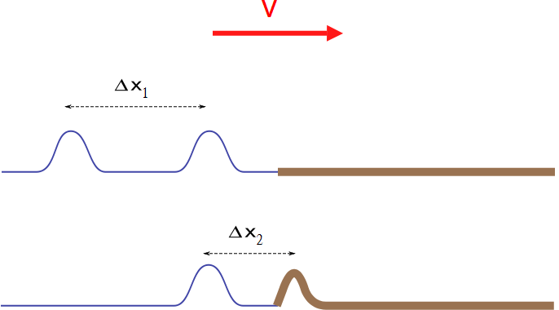

Slide 12
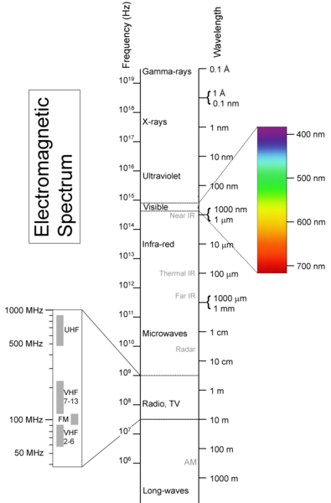
From Materialscientist, used under the Creative Commons Attribution-Share Alike 2.5 Generic License.

Slide 13
Intensity
r
Point Source

Slide 14
Intensity in W/m²
Distance in meters

Slide 15
Intensity
1m
2m
3m
30m
20m
10m

